Slide 1
Welcome
Notes:
Press Record, Ask participants to mute their mics if they are not talking

Slide 2
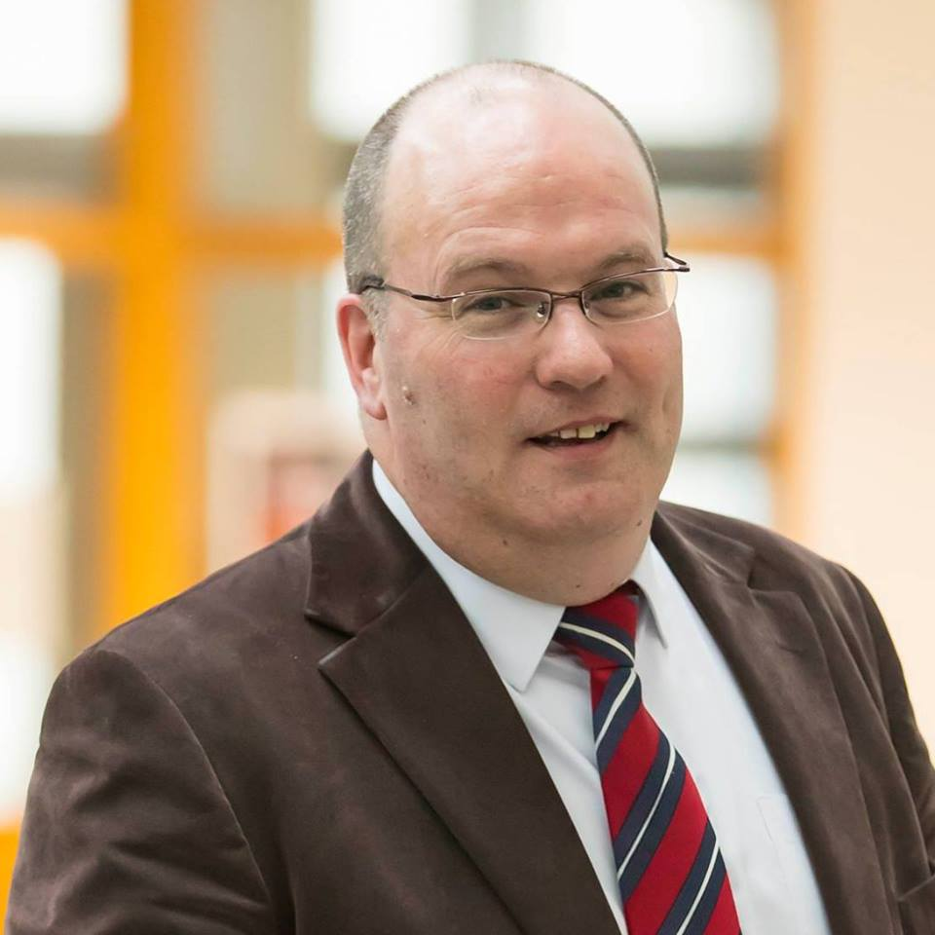
Ken McCarthy
About Me
General Demonstration
Moodle Quiz - Overview
Padlet - Collaboration
Mentimeter - Participation
H5P - Interaction
Please feel free to ask questions
But, I might not know the answers!
Head of Technology-Enhanced Learning (Acting) Waterford Institute of Technology

Slide 3
About Me
Husband of One, Son of Two, Father of Three
Most of my professional life was spent working in the family business which was mainly motor dealerships but a few other things as well.
Education was a late career choice as a result of business closure in 2011
I studied a Higher Diploma in WIT and an MSc in DCU as a Springboard Student
Prior to working in CTEL I spent three years as Springboard Coordinator in WIT
Joined CTEL just over three years ago as Instructional Designer and became acting Head of Centre in January

Slide 4
CTEL (Centre for Technology-Enhanced Learning)
The Centre for Technology-Enhanced Learning (CTEL), first established in 2008, resides in the School of Lifelong Learning and Education.
CTEL is committed to the ongoing development of a vibrant culture of Technology-Enhanced Learning in WIT.

Slide 5
The Team
Fiona Murphy
Cathal O’Riordan
Conor O’Neill
Peter Windle
Vacant
Senior Administrator Student Support Lecturer Support
Learning Technologist Systems Administrator
Learning Technologist Lecturer Support
Learning Technologist TEL PODs
Instructional Designer

Slide 6
(More than) Moodle
Digital Teaching & Learning
Some elements include
Moodle
H5P
Turnitin
Adobe Connect / Zoom
TEL PODs

Slide 7
TEL PODs
Ease of Use
High Quality
One Button Operation
HD Video Streaming
Video Streaming
Lecture Delivery
Self-Service video recording and streaming
Streamed and recorded via YouTube live
Used exclusively on the Hdip in Computer Science

Slide 8
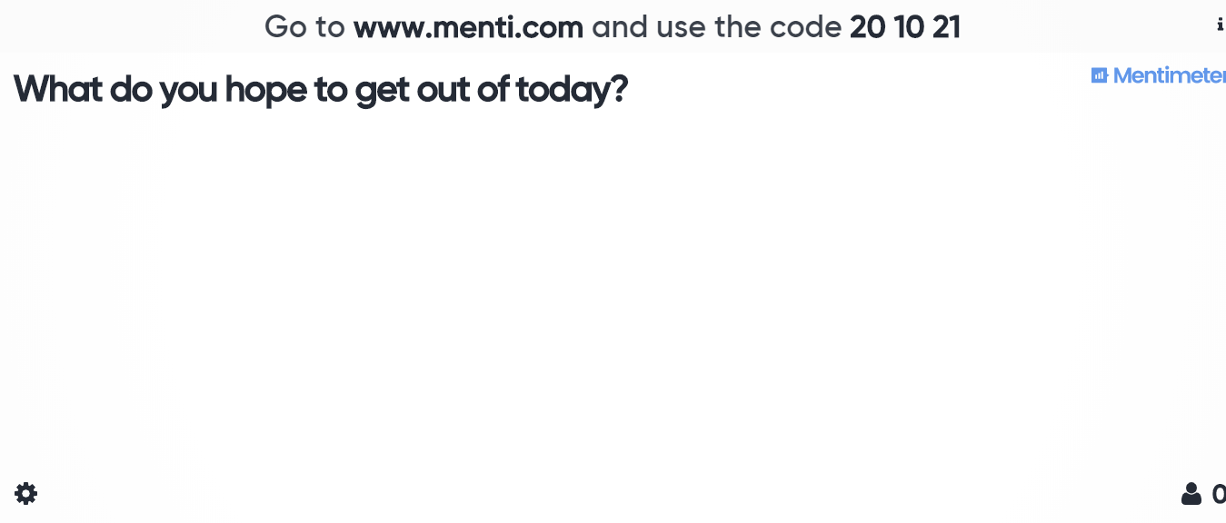
Mentimeter
http://www.menti.com code 20 10 21

Slide 9
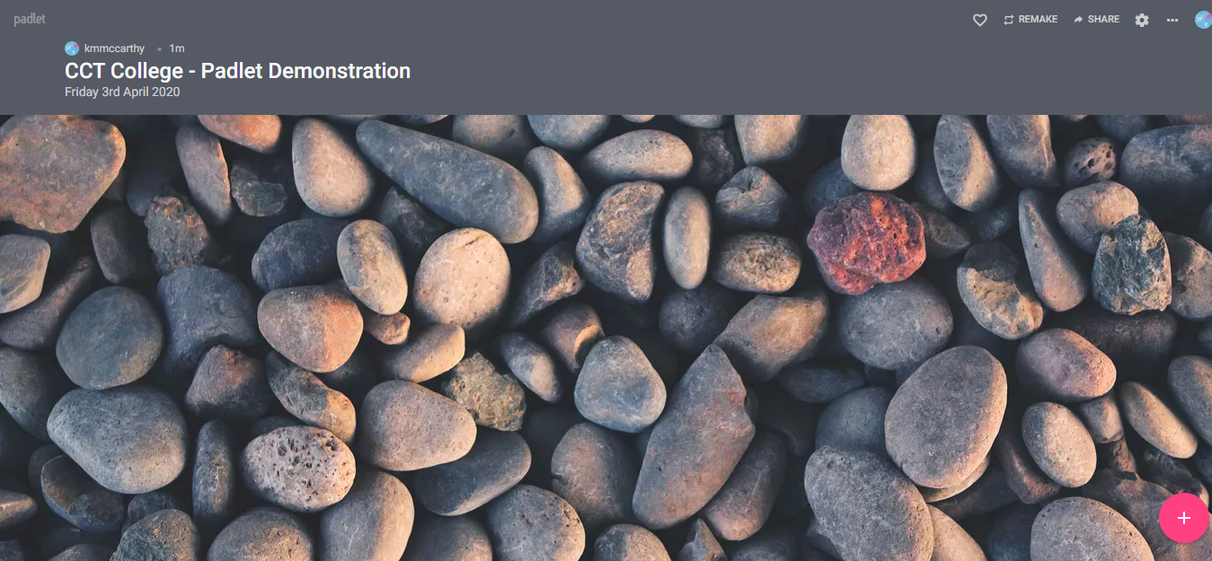
Padlet
http://tiny.cc/cct_padlet

Slide 10
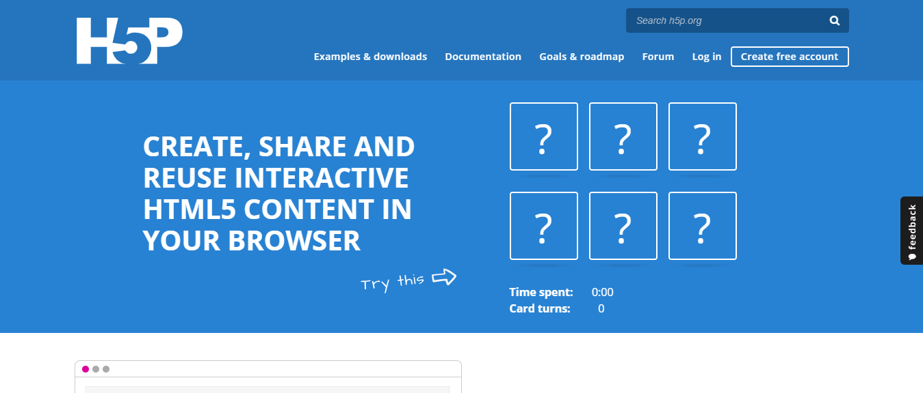
H5P
https://h5p.org/

Slide 11
Thank You
Ken McCarthy
+353 87 367 2728
kmmccarthy@wit.ie
http://ctel.wit.ie/

